Slide 1
Data Pre-Processing
By - Dr. Amit Rathi, Dept of CSE,
JUET, Guna

Slide 2
What is Data preprocessing?
Data preprocessing is a crucial step in the data analysis and machine learning that involves transforming raw data into a clean and usable format.
It involve a series of steps designed to prepare and enhance the quality of the data, ensuring that it is suitable for further analysis and modeling.
The main goals of data preprocessing are to remove noise, handle missing values, normalize data, and generally improve data quality.

Slide 3
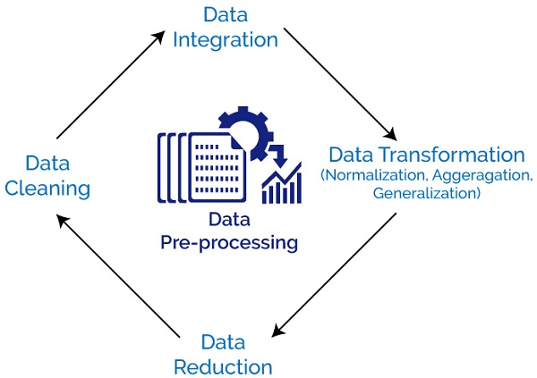

Slide 4
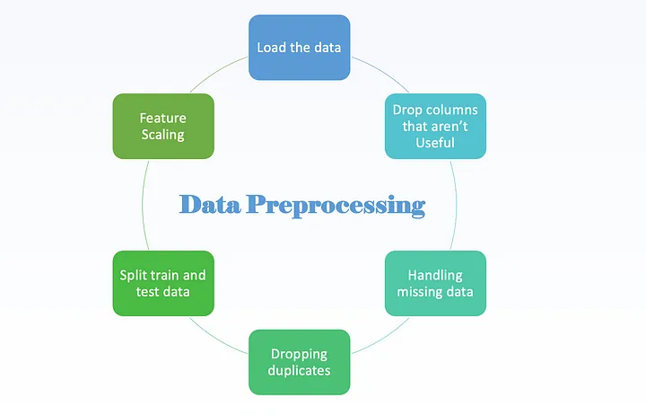

Slide 5
Key steps involved in data preprocessing
1. Data Cleaning:
  Handling Missing Values: Filling in missing values using methods like mean, median, mode imputation, or removing records with missing values.
  Removing Noise and Outliers: Identifying and eliminating outliers and noise (irrelevant or random variations in data) to improve data quality.
  Correcting Errors: Fixing errors in data entries, such as typos or incorrect values.

Slide 6
Key steps involved in data preprocessing
2. Data Integration:
  Combining Data from Multiple Sources: Merging data from different sources to create a unified dataset.
  Ensuring Consistency: Resolving conflicts and ensuring consistent data representation across merged datasets.

Slide 7
Key steps involved in data preprocessing
3. Data Transformation:
  Normalization and Scaling: Adjusting the range of data features to ensure they have a common scale, typically using techniques like min-max scaling or z-score normalization.
  Encoding Categorical Variables: Converting categorical data into numerical format using techniques like one-hot encoding or label encoding.
  Feature Engineering: Creating new features or modifying existing ones to better capture the underlying patterns in the data.

Slide 8
Key steps involved in data preprocessing
4. Data Reduction:
  Dimensionality Reduction: Reducing the number of features in a dataset using techniques like Principal Component Analysis (PCA) or Feature Selection to improve computational efficiency and reduce the risk of overfitting.
  Aggregation: Summarizing data to reduce the dataset size while preserving important information.
5. Data Discretization:
  Binning: Converting continuous data into discrete bins or intervals to simplify analysis and modeling.

Slide 9
Key steps involved in data preprocessing
6. Data Splitting:
  Training and Testing Sets: Dividing the dataset into separate subsets for training and testing purposes to evaluate the performance of machine learning models.
  Effective data preprocessing is essential for ensuring that the data used in analysis and modeling is accurate, consistent, and relevant. It directly impacts the quality of insights and the performance of machine learning algorithms, making it a fundamental step in any data-driven project.

Slide 10
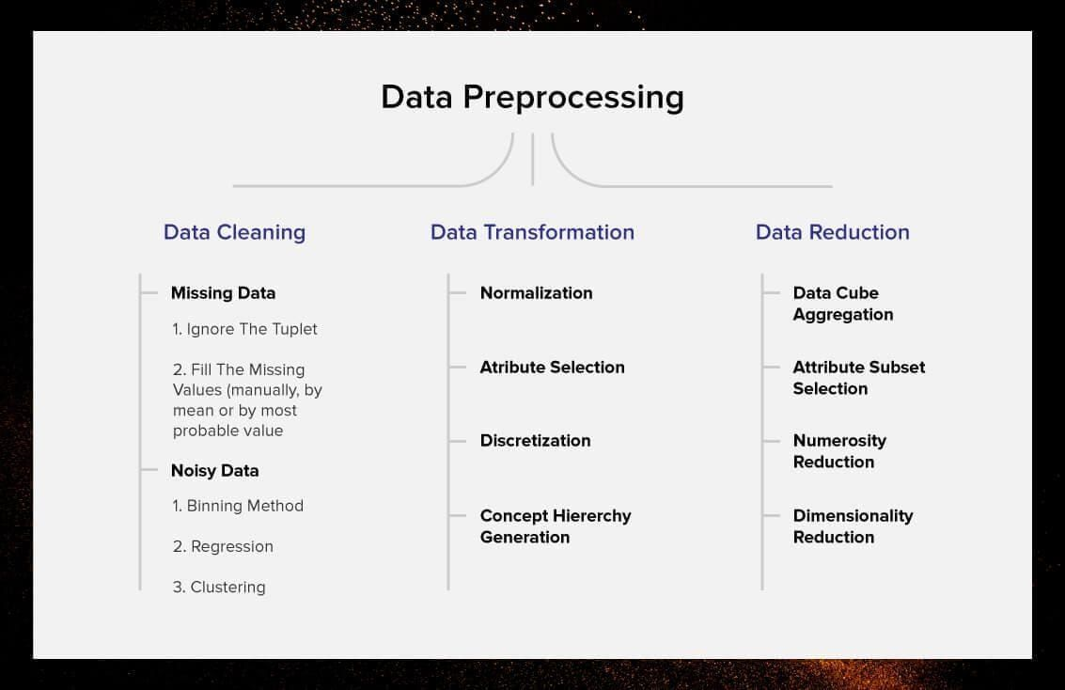

Slide 11
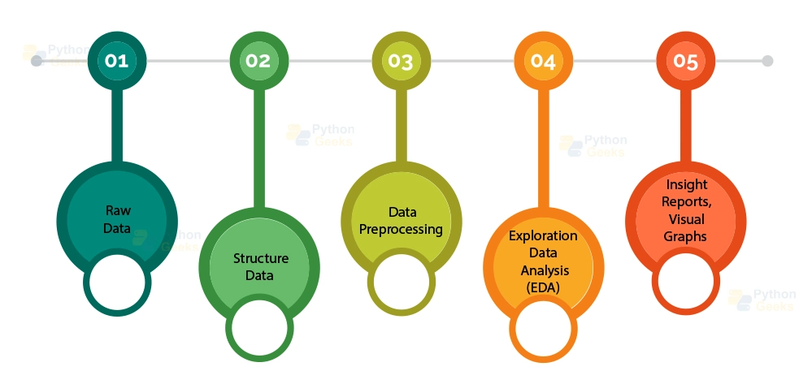

Slide 12
Key Step 1. Data Cleaning
  Data cleaning, also known as data cleansing or data scrubbing, involves identifying and correcting errors, inconsistencies, and inaccuracies in a dataset to improve its quality.
  Common methods used in data cleaning:
1. Handling Missing Values:
Deletion: Removing rows or columns with missing values. This is simple but may result in a significant loss of data if missing values are widespread.
  Listwise Deletion: Removing any row with at least one missing value.
  Pairwise Deletion: Removing only the specific missing values, keeping other parts of the data.

Slide 13
Key Step 1. Data Cleaning
1. Handling Missing Values (contd..):
Imputation: Filling in missing values with estimated values.
  Mean/Median/Mode Imputation: Replacing missing values with the mean, median, or mode of the column.
  K-Nearest Neighbors (KNN) Imputation: Using the values of nearest neighbors to estimate the missing value.
  Regression Imputation: Predicting the missing value based on a regression model using other available data.

Slide 14
Key Step 1. Data Cleaning
2. Removing Duplicates:
  Exact Duplicates: Identifying and removing rows that are completely identical.
  Approximate Duplicates: Using algorithms to detect nearly identical records, considering minor variations.
3. Handling Outliers:
  Statistical Methods: Using methods such as the Z-score or IQR (Interquartile Range) to identify and remove or cap outliers.
  Domain Knowledge: Leveraging domain-specific knowledge to identify and handle outliers appropriately.

Slide 15
Key Step 1. Data Cleaning
4. Standardization and Normalization:
  Standardization: Scaling data to have a mean of zero and a standard deviation of one, which is useful for algorithms that assume normally distributed data.
  Normalization: Scaling data to fit within a specific range, typically 0 to 1, which is useful for ensuring that no single feature dominates others due to differing scales.
5. Correction of Errors:
  Typographical and Syntax Errors: Identifying and correcting spelling mistakes, typos, and syntax errors.
  Logical Consistency: Ensuring that the data follows logical rules (e.g., a start date should be earlier than an end date).

Slide 16
Key Step 1. Data Cleaning
6. Data Transformation:
  Data Type Conversion: Converting data to appropriate types (e.g., integers, floats, dates).
  Encoding Categorical Variables: Converting categorical data into numerical formats using techniques like one-hot encoding or label encoding.
7. Data Integration:
  Merging Datasets: Combining data from different sources into a single cohesive dataset, ensuring consistency in format and values.
  Resolving Conflicts: Handling discrepancies and conflicts when merging datasets, such as different formats or conflicting values.

Slide 17
Key Step 1. Data Cleaning
8. Data Reduction:
  Aggregation: Summarizing data to reduce the dataset size while preserving important information.
  Feature Selection: Choosing a subset of relevant features for analysis to reduce dimensionality.
9. Validation and Verification:
  Cross-Validation: Verifying the cleaned data against known standards or rules to ensure accuracy.
  Manual Review: Manually inspecting samples of the data to ensure that automated cleaning processes have not introduced errors.

Slide 18
Key Step 1. Data Cleaning
10. Consistency Checks:
  Uniformity: Ensuring consistency in data formats and conventions (e.g., date formats, units of measurement).
  Range Checks: Verifying that data values fall within acceptable ranges.
Implementing these methods helps in ensuring the data is accurate, complete, and ready for analysis or modeling, thereby improving the reliability and validity of the insights derived from it.

Slide 19
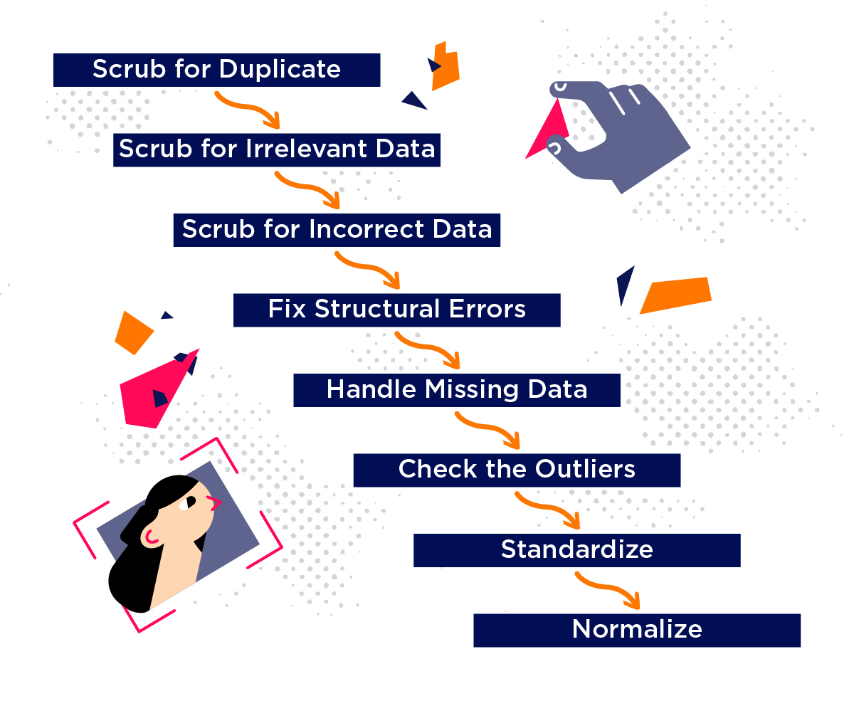

Slide 20
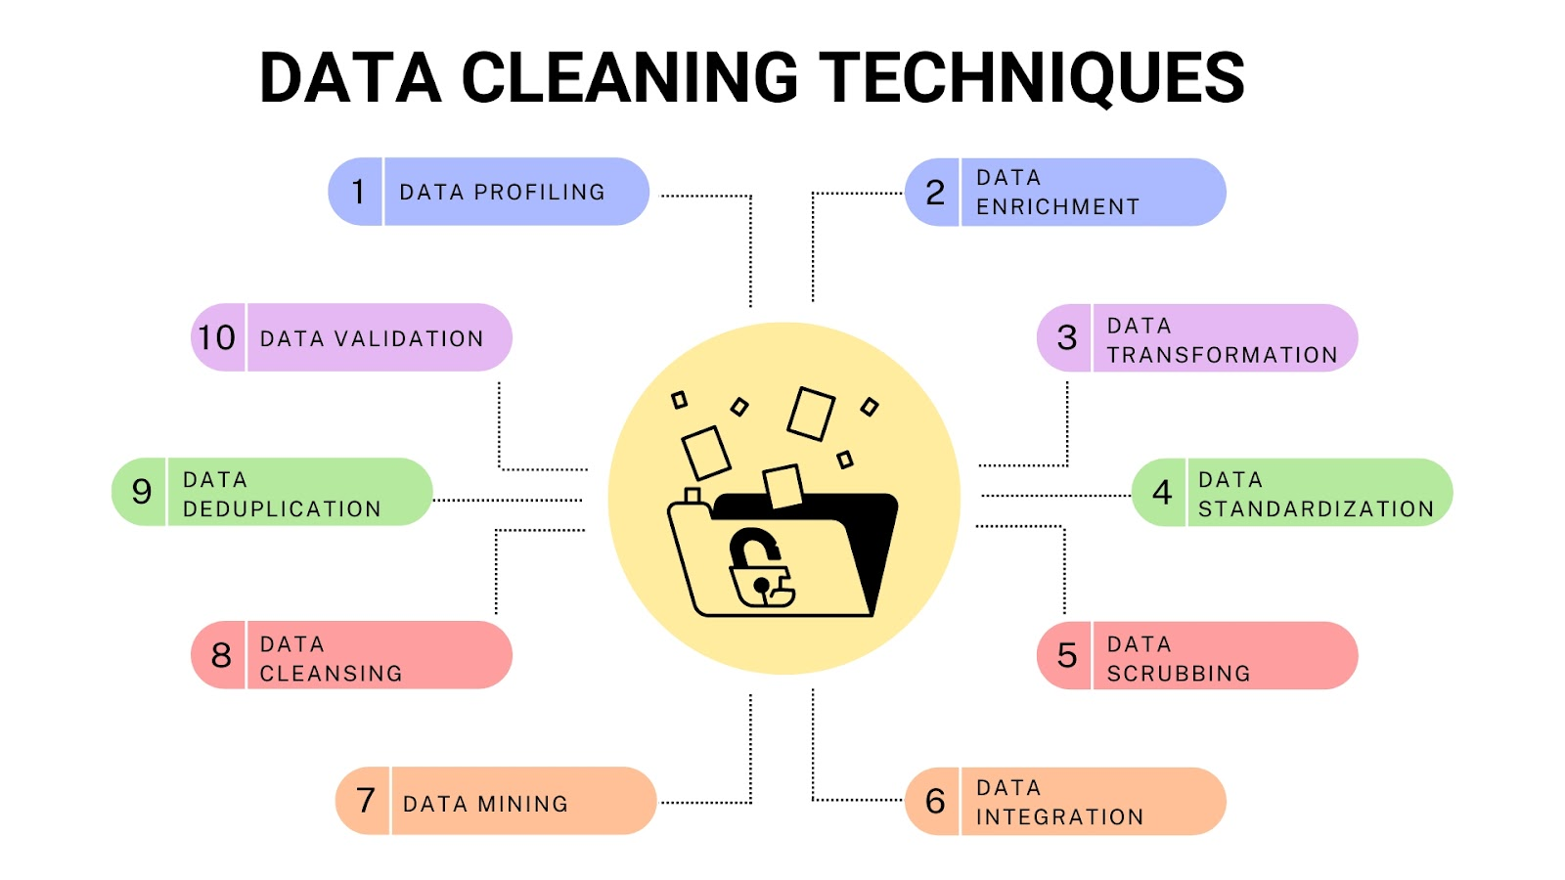

Slide 21
Key Step 2. Data integration
Data integration involves combining data from different sources to provide a unified view. This process is essential for ensuring that data is consistent, accurate, and usable for analysis or operations. Here are the primary methods of data integration:
1. Manual Integration:
  Manual Data Entry: Manually combining data from different sources. This method is error-prone and time-consuming but can be useful for small datasets or when automated methods are not feasible.

Slide 22
Key Step 2. Data integration
2. Middleware Data Integration:
  Enterprise Service Bus (ESB): A middleware solution that allows different systems to communicate and share data through a common communication bus.
  Message-Oriented Middleware (MOM): Uses messages to facilitate data exchange between disparate systems, ensuring data consistency and real-time integration.

Slide 23
Key Step 2. Data integration
3. Data Warehousing:
  ETL (Extract, Transform, Load): Extracting data from various sources, transforming it to fit the desired format, and loading it into a data warehouse. This method is commonly used for batch processing and historical data integration.
    Extract: Collecting data from multiple sources.
    Transform: Cleaning, transforming, and structuring the data.
    Load: Loading the transformed data into a target database or data warehouse.
  ELT (Extract, Load, Transform): Similar to ETL but with the transformation step occurring after loading data into the data warehouse.

Slide 24
Key Step 2. Data integration
4. Data Virtualization:
  Virtual Data Integration: Providing a unified view of data from different sources without physically moving or transforming the data. This method uses a virtual layer that allows users to access and query data in real-time.
5. Application-Based Integration:
  Integration Applications: Using dedicated software applications to integrate data from different sources. These applications often provide connectors and APIs to facilitate data exchange.
  Custom Integration Solutions: Developing custom scripts or programs to integrate data based on specific requirements.

Slide 25
Key Step 2. Data integration
6. Data Consolidation:
  Centralized Database: Consolidating data from different sources into a single, centralized database. This approach ensures that all data is stored in a consistent format and is easily accessible.
  Master Data Management (MDM): Ensuring consistency and accuracy of key data entities (e.g., customer data) across the organization.
7. Federated Databases:
  Federated Database Systems: Allowing multiple databases to function as a single unified database. Each database remains autonomous but is accessible through a common interface.

Slide 26
Key Step 2. Data integration
8. Cloud-Based Integration:
  iPaaS (Integration Platform as a Service): Cloud-based platforms that provide tools and services to integrate data from different cloud and on-premises sources.
  Cloud Data Warehousing: Using cloud-based data warehouses to integrate and store data from various sources.
9. API-Based Integration:
  APIs (Application Programming Interfaces): Using APIs to enable data exchange between different systems. APIs provide a standardized way to access and integrate data in real-time.

Slide 27
Key Step 2. Data integration
10. Big Data Integration:
  Data Lakes: Storing large volumes of structured and unstructured data in its raw format. Data from different sources can be ingested and later processed as needed.
  Hadoop/Spark-Based Integration: Using big data technologies like Hadoop and Spark to integrate and process large datasets from various sources.
Each method has its advantages and is suitable for different scenarios depending on factors such as data volume, integration frequency, data types, and specific organizational needs. Effective data integration ensures that data is accurate, consistent, and readily available for analysis, enabling better decision-making and operational efficiency.

Slide 28
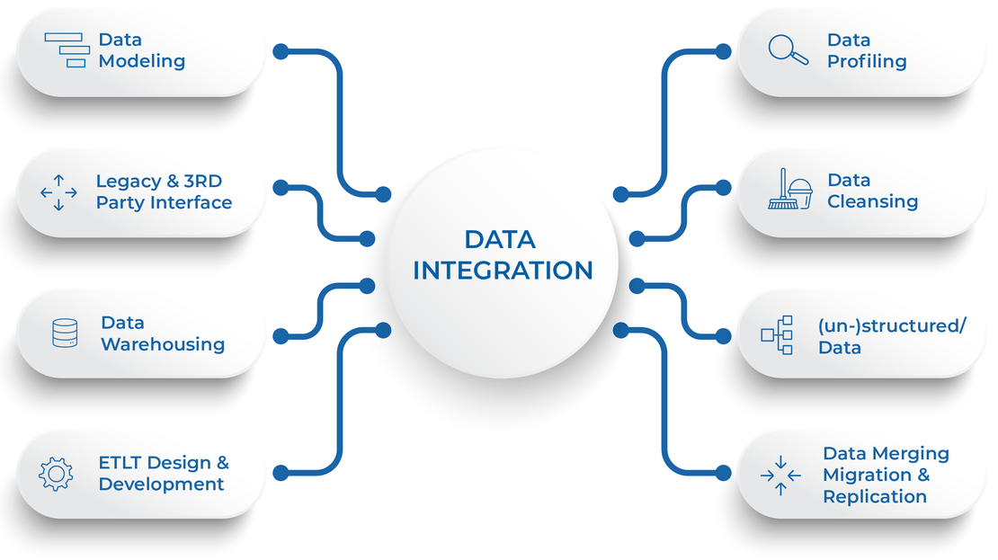

Slide 29
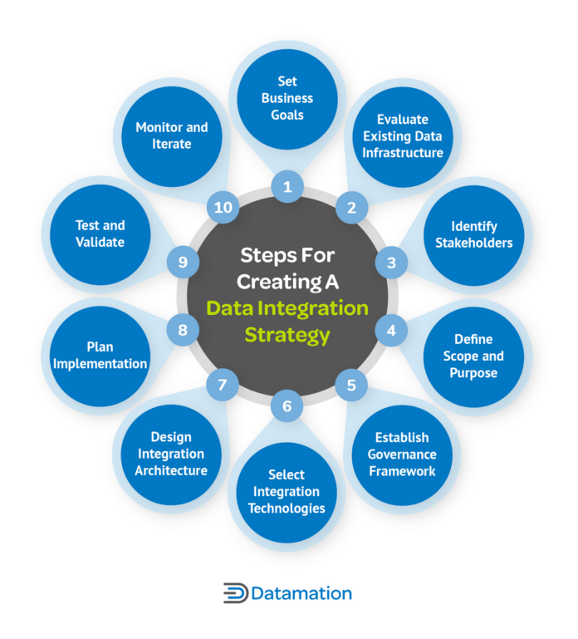

Slide 30
Key Step 3. Data Transformation
Mathematical transformations on the data to make it more suitable for modeling.
This may include transformations such as logarithmic transformation, square root transformation, or Box-Cox transformation to stabilize variance.
These transformations can help stabilize variance, address skewness, or make the data more interpretable.

Slide 31
Key Step 3. Data Transformation
Here are some common mathematical transformations used in data science:
1. Logarithmic Transformation:
  Logarithmic transformation is used to reduce the magnitude of data values, especially when the data is highly skewed or has a long-tailed distribution.
  It is particularly useful for data with exponential growth patterns. The logarithm function can transform highly skewed data into a more symmetric distribution.
log⁡(𝑥) or log ₁₀ (𝑥)
2. Square Root Transformation:
  Square root transformation is another method to reduce the skewness of data.
  It is particularly effective for data with right-skewed distributions, where the higher values dominate the distribution.
  √ x

Slide 32

Key Step 3. Data Transformation
3. Cube Root Transformation: Similar to square root transformation, cube root transformation is used to reduce the skewness of data.
It is more aggressive in reducing the skewness compared to square root transformation.
∛x
4. Box-Cox Transformation: Box-Cox transformation is a family of power transformations that includes both logarithmic and square root transformations as special cases.
It is used to stabilize variance and make the data more normally distributed. The optimal lambda (𝜆) parameter for Box-Cox transformation can be estimated from the data.
for 𝜆≠0
log⁡(𝑥) for 𝜆 = 0

Slide 33
Key Step 3. Data Transformation
5. Exponential Transformation: Exponential transformation is used to emphasize the exponential growth or decay patterns in the data.
It can be helpful in analyzing data with multiplicative relationships.
e^{x}
6. Inverse Transformation: Inverse transformation is used to reverse the effect of other transformations, such as logarithmic or square root transformations.
It can be applied to transform data back to its original scale after analysis.
1/x

Slide 34
Key Step 3. Data Transformation
7. Sigmoid Transformation: Sigmoid transformation is used to squash data into a specific range, typically between 0 and 1.
It is commonly used in logistic regression or when dealing with probabilities.
1/1+𝑒^{−𝑥}
These mathematical transformations are applied based on the characteristics of the data and the assumptions of the analysis or modeling techniques being used.
It's important to assess the effectiveness of these transformations and choose the one that best suits the data and the analysis goals.
Additionally, it's crucial to consider the interpretability of the transformed data and ensure that the transformed values retain their original meaning.

Slide 35
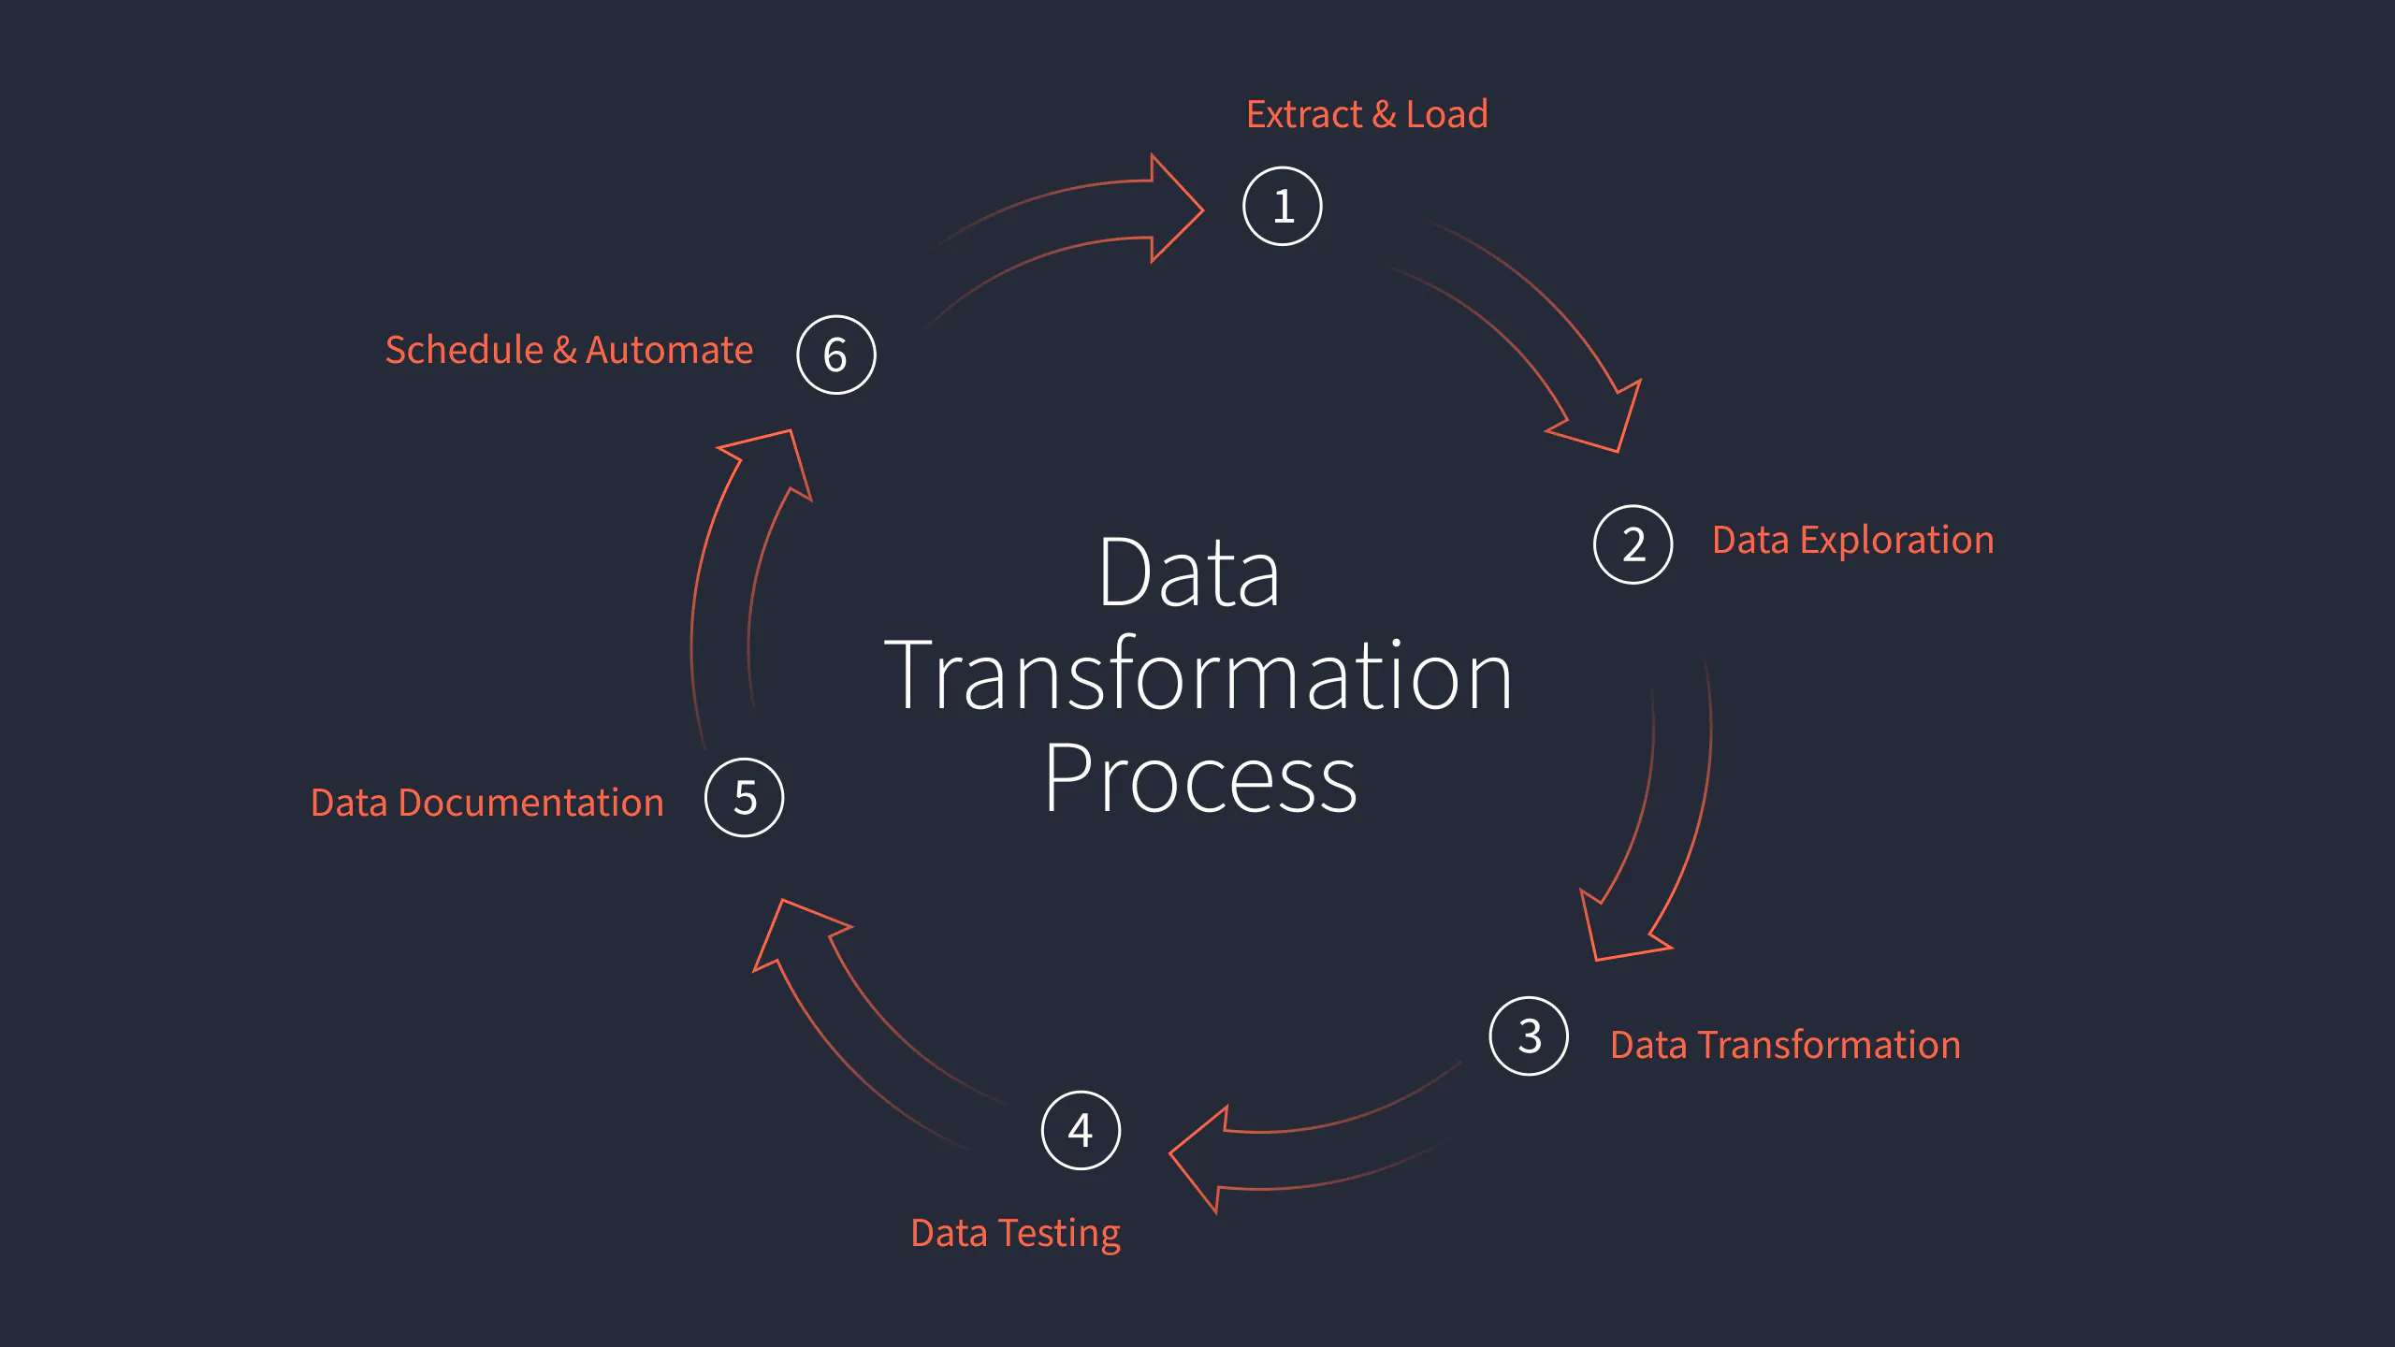

Slide 36
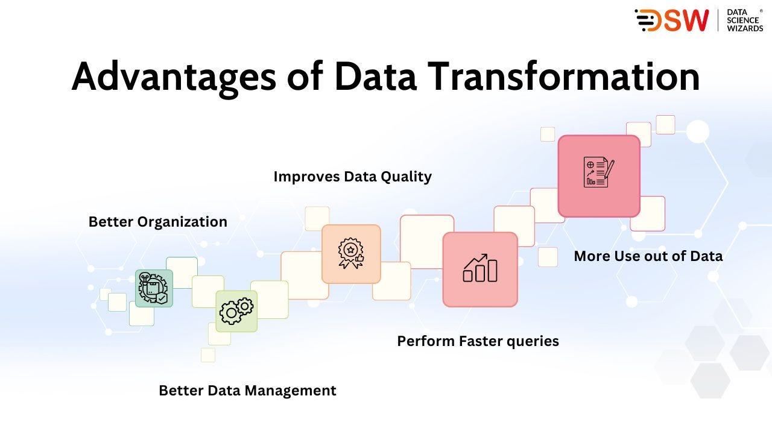

Slide 37
Key Step 4. Data reduction
Data reduction is the process of reducing the dimensionality or size of a dataset while preserving its important characteristics.
It's particularly useful in data science when dealing with large datasets or when trying to simplify the dataset for analysis or modeling.
Here are the steps involved in data reduction in data science:
Feature Selection: Identify the subset of features (variables) from the dataset that are most relevant to the analysis or modeling task.
Feature selection techniques aim to eliminate irrelevant or redundant features, thereby reducing the dimensionality of the dataset. Common methods include:
  Filter Methods: Evaluate each feature independently of the others based on statistical measures like correlation, mutual information, or chi-square test.
  Wrapper Methods: Use a predictive model to evaluate the importance of subsets of features through a search process (e.g., forward selection, backward elimination).
  Embedded Methods: Feature selection is incorporated into the model training process itself, where the importance of features is learned during model training (e.g., LASSO regression, decision trees).

Slide 38
Key Step 4. Data reduction
2. Dimensionality Reduction: Reduce the number of dimensions (variables) in the dataset while preserving its important characteristics.
Dimensionality reduction techniques aim to transform the dataset into a lower-dimensional space, making it more manageable for analysis or modeling. Common methods include:
  Principal Component Analysis (PCA): A linear dimensionality reduction technique that identifies the directions (principal components) that maximize the variance in the data.
  Linear Discriminant Analysis (LDA): A supervised dimensionality reduction technique that maximizes the separation between classes in the dataset.
  t-distributed Stochastic Neighbor Embedding (t-SNE): A non-linear dimensionality reduction technique that preserves local structure in high-dimensional data.

Slide 39
Key Step 4. Data reduction
3. Clustering: Group similar data points (instances) together into clusters, where each cluster represents a subset of the data with similar characteristics.
Clustering can be used as a form of data reduction by summarizing the dataset using a smaller number of cluster centroids or prototypes.
  K-means Clustering: Partition the data into K clusters by iteratively assigning data points to the nearest cluster centroid and updating the centroids based on the mean of the assigned points.
  Hierarchical Clustering: Build a hierarchy of clusters by recursively merging or splitting clusters based on their similarity.

Slide 40
Key Step 4. Data reduction
4. Sampling: Reduce the size of the dataset by sampling a subset of data points.
Sampling methods can be used to create smaller representative datasets that maintain the essential characteristics of the original dataset. Common sampling techniques include:
  Random Sampling: Select data points randomly from the dataset.
  Stratified Sampling: Ensure that the distribution of classes or important characteristics in the sampled dataset matches that of the original dataset.
  Cluster Sampling: Divide the dataset into clusters and sample entire clusters rather than individual data points.

Slide 41
Key Step 4. Data reduction
5. Data Aggregation: Aggregate the dataset to a coarser level of granularity by summarizing or combining data points.
Aggregation can reduce the size of the dataset while preserving important trends or patterns. Common aggregation methods include:
  Summarization: Calculate summary statistics (e.g., mean, median, count) for groups of data points.
  Temporal Aggregation: Aggregate data over time periods (e.g., hours, days, months) to analyze trends at different temporal resolutions.
By following these steps, data scientists can effectively reduce the dimensionality or size of a dataset while retaining its important characteristics, making it more manageable for analysis or modeling tasks.

Slide 42
Key Step 5. Data discretization
Data discretization is the process of converting continuous variables into discrete or categorical variables.
This can be useful for various reasons, including reducing the complexity of the data, handling noisy data, and preparing it for certain types of analysis or modeling.
Here are the steps involved in data discretization in data science:
1.Choose Variables: Identify the continuous variables in the dataset that you want to discretize. These variables could be numerical features that you believe would benefit from being represented as discrete categories.
2. Explore Data Distribution: Understand the distribution of the continuous variables to be discretized. This involves examining summary statistics, histograms, density plots, or other visualization techniques to understand the range, central tendency, and spread of the data.

Slide 43
Key Step 5. Data discretization
3. Select Discretization Method: Choose an appropriate discretization method based on the characteristics of the data and the analysis or modeling goals.
Common discretization methods include:
  Equal Width Binning: Divide the range of the variable into a specified number of equal-width bins.
  This method divides the range of the variable into intervals of equal size, regardless of the distribution of the data.
  Equal Frequency Binning: Divide the data into a specified number of bins, each containing approximately the same number of data points.
  This method ensures that each bin has a similar number of observations, but the intervals may vary in width.
  Clustering-Based Binning: Use clustering algorithms (e.g., k-means clustering) to identify natural groupings in the data and define bins based on the cluster centroids.
  Entropy-Based Binning: Divide the data into bins to maximize the information gain or minimize the entropy of the resulting categories. This method aims to find the most informative way to discretize the data.

Slide 44
Key Step 5. Data discretization
  Clustering-Based Binning: Use clustering algorithms (e.g., k-means clustering) to identify natural groupings in the data and define bins based on the cluster centroids.
  Entropy-Based Binning: Divide the data into bins to maximize the information gain or minimize the entropy of the resulting categories.
  This method aims to find the most informative way to discretize the data.

Slide 45
Key Step 5. Data discretization
4. Discretize Data: Apply the chosen discretization method to the continuous variables in the dataset.
This involves dividing the range of each variable into discrete intervals or categories according to the specified criteria.
5. Assign Labels: Once the data has been discretized, assign labels or categories to each interval or bin.
These labels can be numerical (e.g., 1, 2, 3) or categorical (e.g., low, medium, high) depending on the context and the analysis requirements.
6. Validate Discretization: Evaluate the effectiveness of the discretization process by examining the distribution of the discretized variables and assessing whether the resulting categories capture meaningful patterns in the data.
This may involve visual inspection, statistical tests, or domain knowledge validation.

Slide 46
Key Step 5. Data discretization
7. Handle Special Cases: Consider how to handle special cases such as missing values or outliers during the discretization process. Depending on the method used, missing values may be assigned to a separate category, imputed, or handled differently.
8. Document Transformation: Document the discretization process, including the chosen method, parameters, and any decisions made during the process. This documentation is essential for transparency and reproducibility in data analysis workflows.
By following these steps, data scientists can effectively discretize continuous variables in a dataset, making it more suitable for certain types of analysis or modeling tasks that require categorical or ordinal data.

Slide 47
Key Step 6. Data splitting
Data splitting is a critical step in data science for training, validating, and testing machine learning models.
The purpose of data splitting is to divide the dataset into separate subsets to ensure that the model's performance is accurately assessed on unseen data.

Slide 48
Key Step 6. Data splitting
1. Dataset Preparation: Ensure that the dataset is clean, preprocessed, and ready for analysis. This may involve data cleaning, feature engineering, normalization, and other preprocessing steps.
2. Define the Splitting Strategy: Determine how to split the dataset into training, validation, and testing sets. The most common splitting strategies include:
  Train-Validation-Test Split: Divide the dataset into three subsets: a training set, a validation set, and a testing set. The training set is used to train the model, the validation set is used to tune hyperparameters and evaluate model performance during training, and the testing set is used to assess the final performance of the trained model.
  Cross-Validation: Perform k-fold cross-validation, where the dataset is divided into k subsets (folds), and the model is trained and evaluated k times, each time using a different fold as the validation set and the remaining folds as the training set. Cross-validation provides a more robust estimate of model performance compared to a single train-validation-test split.
  Time-Based Splitting: For time-series data, split the dataset based on a specific time point or time period. This ensures that the model is trained on past data and evaluated on future data, mimicking real-world deployment scenarios.

Slide 49
Key Step 6. Data splitting
3. Split the Dataset: Implement the chosen splitting strategy to partition the dataset into training, validation, and testing sets.
This may involve randomly shuffling the data (for non-time-based splitting) or sorting the data by time (for time-based splitting) before splitting.
Set Aside the Testing Set: Reserve the testing set for final model evaluation and performance assessment.
The testing set should not be used during model training or hyperparameter tuning to ensure an unbiased evaluation of the model's generalization performance.
5. Optional: Preprocessing on Training and Validation Sets: Apply any additional preprocessing steps, such as feature scaling or encoding, separately to the training and validation sets.
It's important to compute any scaling or encoding parameters (e.g., mean, standard deviation) based only on the training set to prevent data leakage.

Slide 50
Key Step 6. Data splitting
6. Model Training and Evaluation: Train the machine learning model using the training set and evaluate its performance using the validation set.
Iterate on model selection, hyperparameter tuning, and feature engineering based on the validation performance until satisfactory results are achieved.
7. Final Model Evaluation: Once the model development process is complete, evaluate the final trained model's performance on the testing set.
This provides an unbiased estimate of the model's performance on unseen data and helps assess its generalization ability.

Slide 51
Key Step 6. Data splitting
8. Documentation: Document the data splitting strategy, including the proportion of data allocated to each subset and any considerations or assumptions made during the process. This documentation ensures reproducibility and transparency in the analysis workflow.
By following these steps, data scientists can effectively split the dataset into appropriate subsets for model training, validation, and testing, ensuring robust model evaluation and reliable performance estimation.

